Slide 1
Appeals and Donation Analysis
Proposal by – (Group 12)
Aparajit; Jasmine Sethi; Kshitij Yadav

Slide 2
Project Motivation
To help a NGO to predict their future trajectory in order to increase donation amounts corresponding to their appeals
Project Description
Demographical factors analysis
This involves knowing the demographic factors which correlate with past behavior and predicting the future behavior. Also, knowing the customer’s lifetime value and recommendation of demographics for acquiring new donors.
Appeals analysis
The main aim was to know about the response to appeals and to find ways to optimize the targeting of appeals. Also, to understanding the limitation on using the current data to optimize the targeting of appeals and describing a field of study to overcome these limitations.
Behavioral factors analysis
This involved knowing about prediction of future donations depending on the past amounts. To measure donors recency and frequency and determine does it have a significant impact on future donations behavior.

Slide 3
Data Description
Appeals Data
Consists of 1,730,598 observations
Comprises of all the appeal details sent to the donors
Variables are as follows:
Donor_id: unique donor id.
Appeal_id: unique appeal id.
Appeal_date: date that appeal was sent.
Appeal_cost: cost of that appeal.
Donations Data
Consists of 192840 observations
Comprises of all the donations corresponding to appeals made by the donor
Variables are as follows:
Donor_id: unique donor id.
Gift_date: date of donation.
Gift_amount: donation amount.
Appeal_id: appeal that donor responded to.
Zipcode: zip code of donor.
First_gift_date: The date of the first donation by this donor
Also, US census data was used for further analysis which included data of US postal codes, Household Income Distribution, Household by Age and Family and population Age and Gender .

Slide 4
Descriptive Statistics

Slide 5
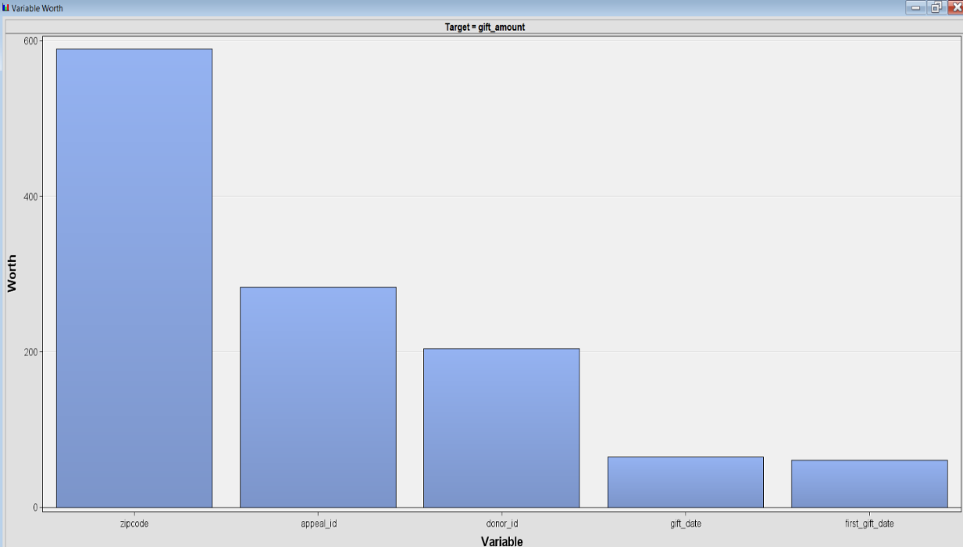
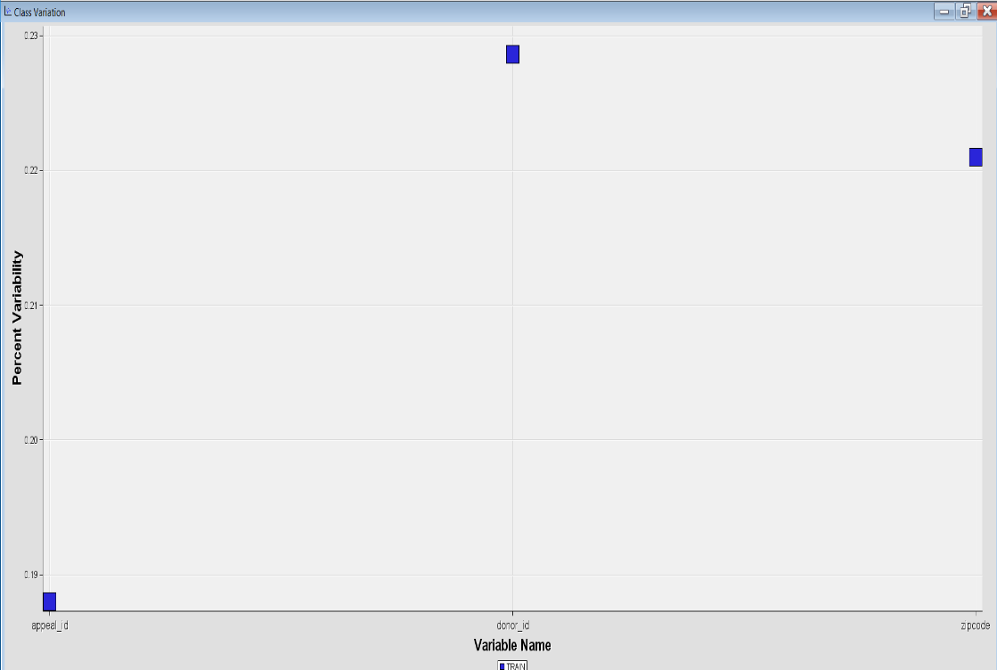
Variable Worth and Variability
Data exploration was done to analyze which predictors are statistically significant
Class Variability of three important factors donors, appeal id and donor id was seen
Zip code and appeal id turned out to be most significant factors
Appeal ids do not vary while Donor id and Zip code vary
Variable Worth
Class Variability

Slide 6
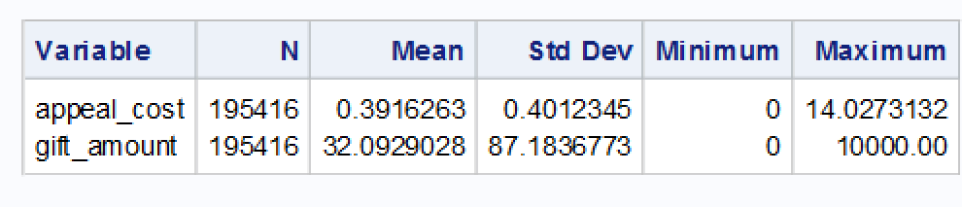
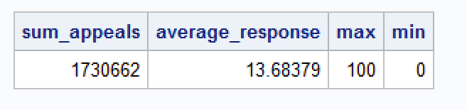
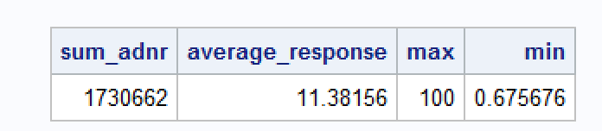
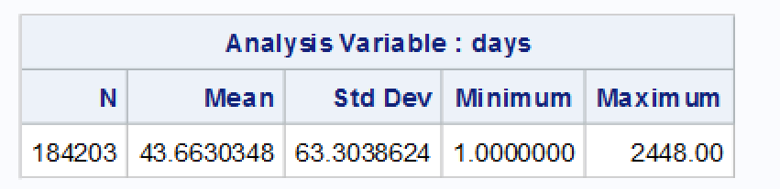
Appeal and Donation Response
The mean of all the appeal cost sent to each donor was 0.391 while mean amount donated by each donor was around $32
The average response rate of appeals and donors are shown below
Donor response rate
Appeal response rate
The maximum time taken to respond back to an appeal was 2448 days. The appeal was sent to donor in 2003 and he donated in 2006
Appeal id 03LCW1CMEE was sent donor id 979281 on Jun 09, 2003 and he donated money on Jan 19, 2006

Slide 7
Data Insights – Descriptive Stats
Appeal id ‘01AKLFM26’ was sent 19312 times and the total appeal cost associated to it was $14484
Appeal id ‘00AKMFAA52’ had appeal cost around $3621 but it was not sent to many users
Maximum number appeals were sent to donor id 8203945 and he donated only 103 times out of 160 times. The total amount donated by this id was around $3325 while the sum of appeal costs was $73.395
Mostly donors donated once or twice for each appeal except three appeals 00AKMFAA524, 03AKMGQRWM, 06WBGAAKDD got three donations by respective donors
Donor id 10017259 paid more than 20 times for an appeal but total sum donated was around $2450
Donor id 9825928 was sent fewer appeals but appeals with higher appeal cost
Appeal Cost sent to him summed up to $85.759 and the donation amount received was $4800
Maximum amount of donations were made by donor id 100030872 around $28500

Slide 8
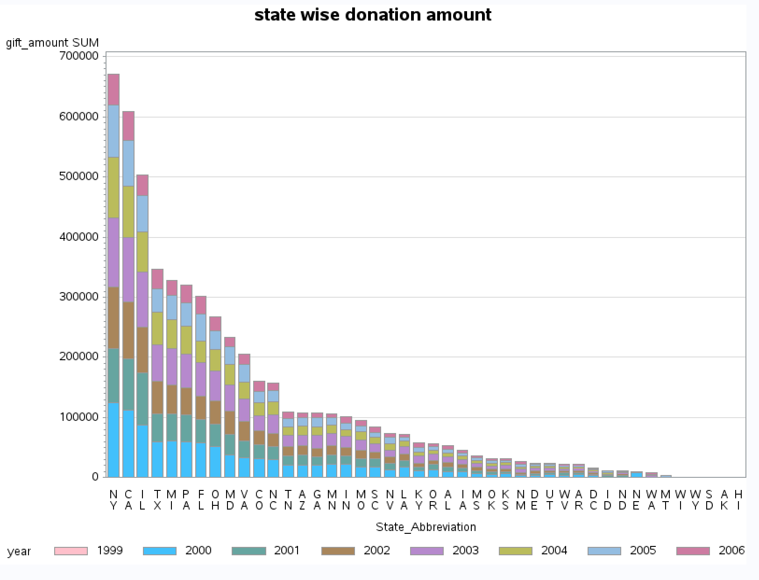
State-wise Donations
Maximum donations were received from New York followed by California and Illinois
Also, donations decrease in subsequent years

Slide 9
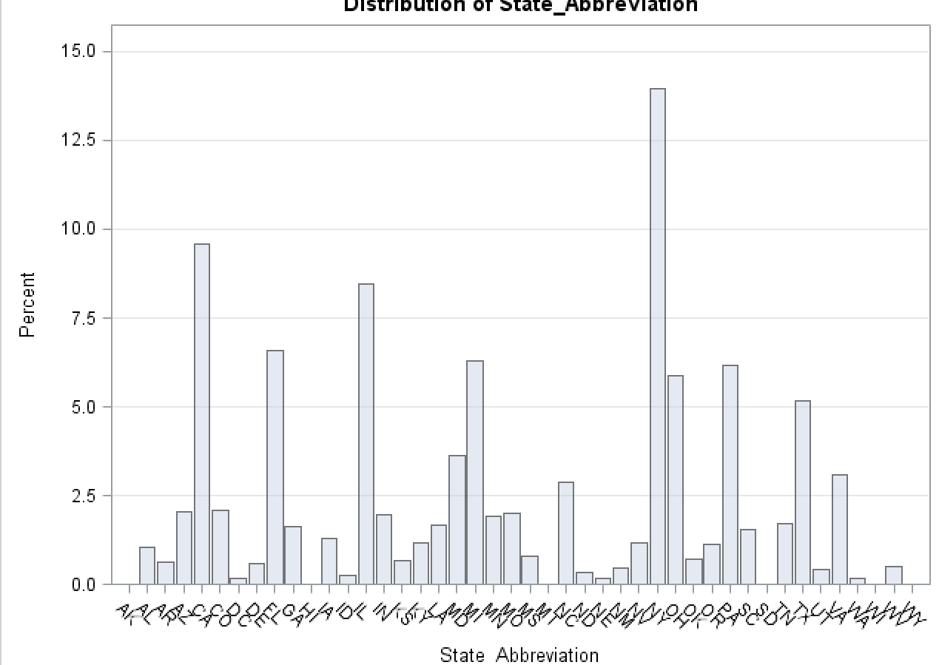
Frequency of donations by each state
As can be seen New York had maximum number of donations as well .

Slide 10
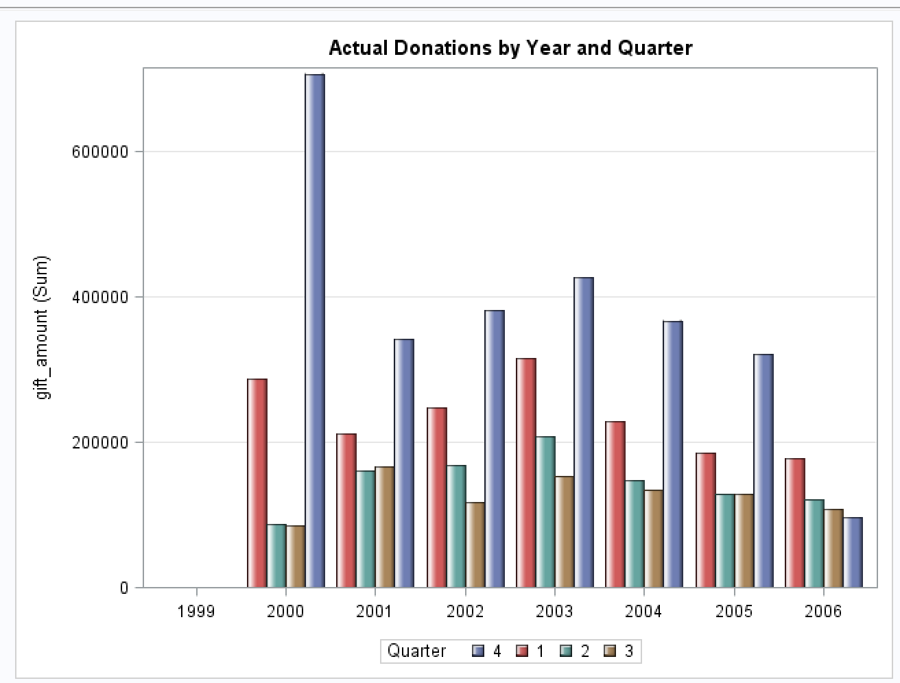
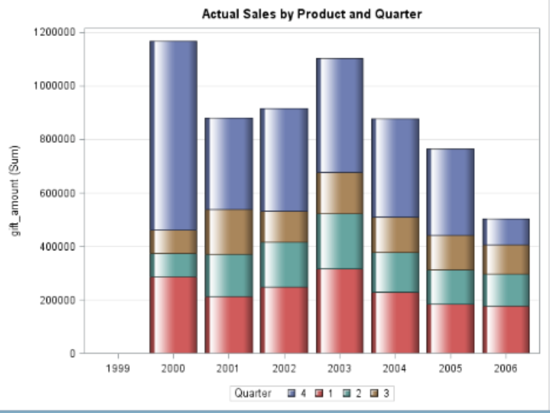
Donations done in each year
Maximum donations happened in the year 2000 when the appeals were first sent
Last Quarter of each year generated most of the donation amount as compared to other quarters
After 2000 a major donation was done only in 2003

Slide 11
Demographic Factor Analysis

Slide 12
Objective
To check if demographic factors have any impact on donation behavior
If customer lifetime value is correlated with demographics
If certain regions can be identified to attract new donors
Donation and Appeal data set was merged basis Donor ID and Appeal ID. This combined data set was merged with US census data.
Census regions( South, West, Northeast, Mid West) were mapped against zip-codes using the US census websites.

Slide 13
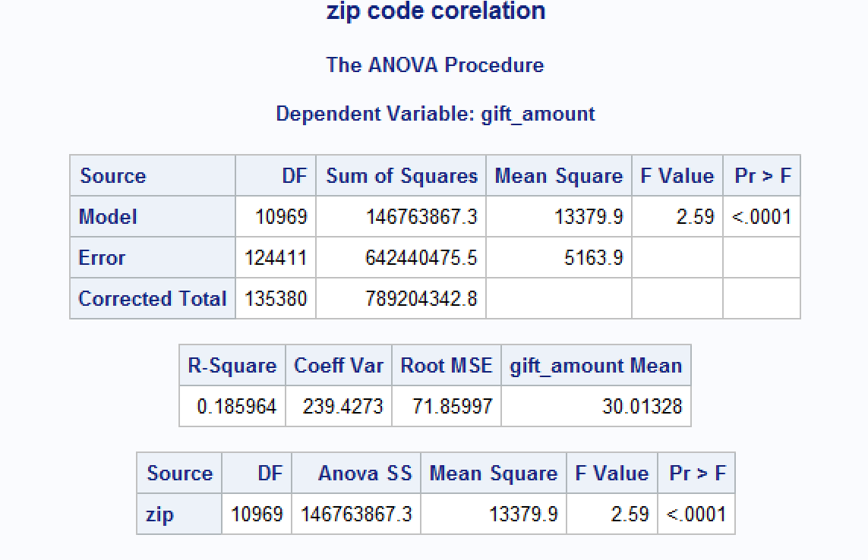
Analysis of Variance
Anova was run to check if Gift Amount varied with change in Zip-codes.
Our Hypothesis for this test were as follow –
H0: μd = μ0 - The means for gift amount is _{equal across zip-codes.}
_{H1: μd ≠ μ0 -} The means for gift amount varies across zip codes.
Since p value is less than 0.05, we reject the null hypothesis.

Slide 14
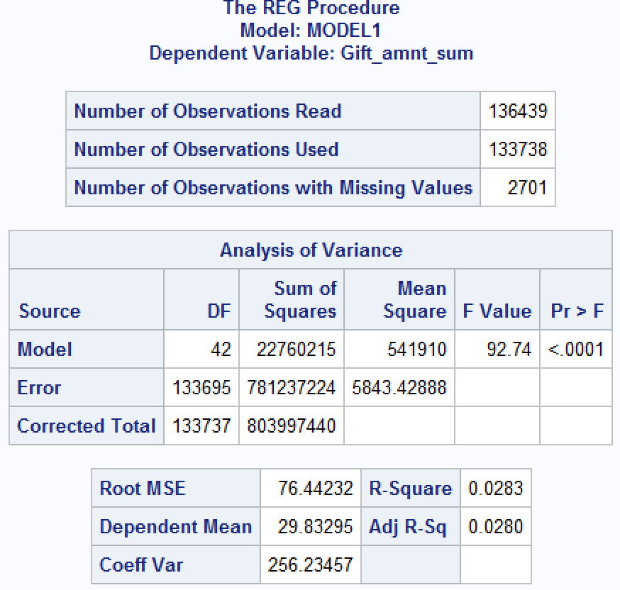
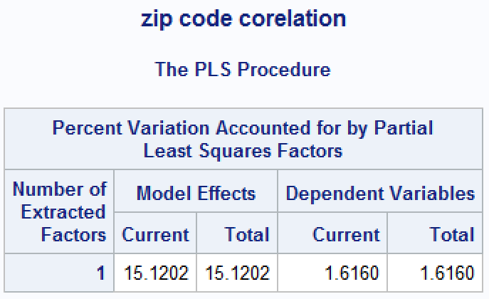
Regression Analysis
Multiple regression models were run with all variables
Many methods were tried – forward , backward, stepwise and MAXR
We failed to find any conclusive evidence of any correlation with demographic factors
Some variables were dropped from the dataset basis our understanding and some were combined to create ne variables to further investigate the relationship

Slide 15
Variable Modification
Using feature selection and VIF some variables were dropped from the models.
New variables were created which are as follows-
working_male=Male_19_to_21 + Male_22_29 + Male_30_44 + Male_45_to_59;
retd_male=Male_60_69 + Male_GT_70;
working_female=Female_19_to_22 + Female_23_29 + Female_30_44 + Female_45_to_59;
retd_female=Female_60_69 + Female_GT_70;
avg_per_household=Total_population/Total_Households;
Basis region, dummy variables were created for each of the regions.
Gift amount was categorized into 4 categories as follow –
if Gift_amount le 10 then cat1="lt_10";
if Gift_amount > 10 and Gift_amount<=50 then cat1="10_50";
if Gift_amount > 50 and Gift_amount<=100 then cat1="50_100";
if Gift_amount ge 100 then cat1="mt_100";
So our target variable was now multi class categorical variable and a multinomial logit could be run to further study the relationship.
Some variables were dropped from the dataset basis our understanding and some were combined to create ne variables to further investigate the relationship

Slide 16
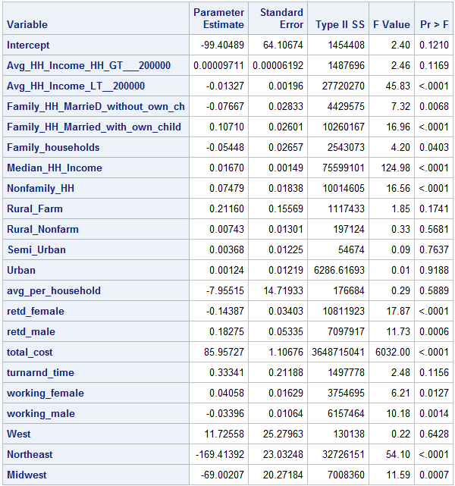
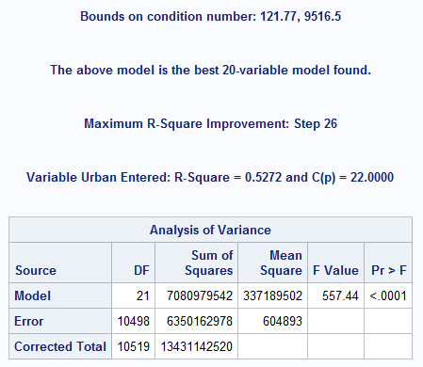
Regression Analysis – Aggregated data
Since the data was at individual level and demographics data was at zip code level not finding a correlation was not surprising
The appeals and donation data was aggregated at zip code level and then merged with the demographics dataset
New variable Turnaroundtime was created which was the time taken by an individual to respond to an appeal . Averages for zip codes were used in the model
A regression model with donation amount as target variable was run
Rsquare value obtained for the model was 0.52

Slide 17
Insights – Aggregated data regression analysis
From the model we can see that the demographic factors are correlated with donation behavior
Average household income does not have much of an impact on the propensity to donate , the wealthy do not necessarily donate more
Married families with kids have a greater tendency to donate than married couples without kids
Median household income is a significant variable with positive coefficient , so cities with higher median incomes would donate more
Retired males tend to donate more than retired females
Weather a particular area is urban or rural or semi urban does not influence donation behavior
Working females donate more than working males

Slide 18
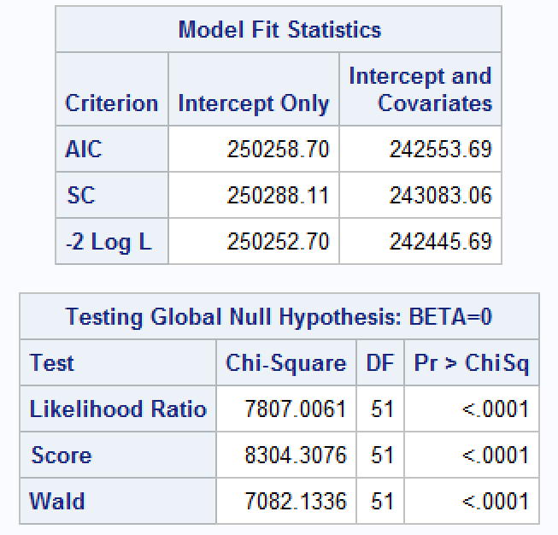
Multinomial Logit
A multinomial logit was run with “Cat1” as the dependent variable.
McFadden’s R square value calculated for this model was 0.0311, which is insignificant.
We concluded that demographic factors doesn't show any correlation with the donation behavior

Slide 19
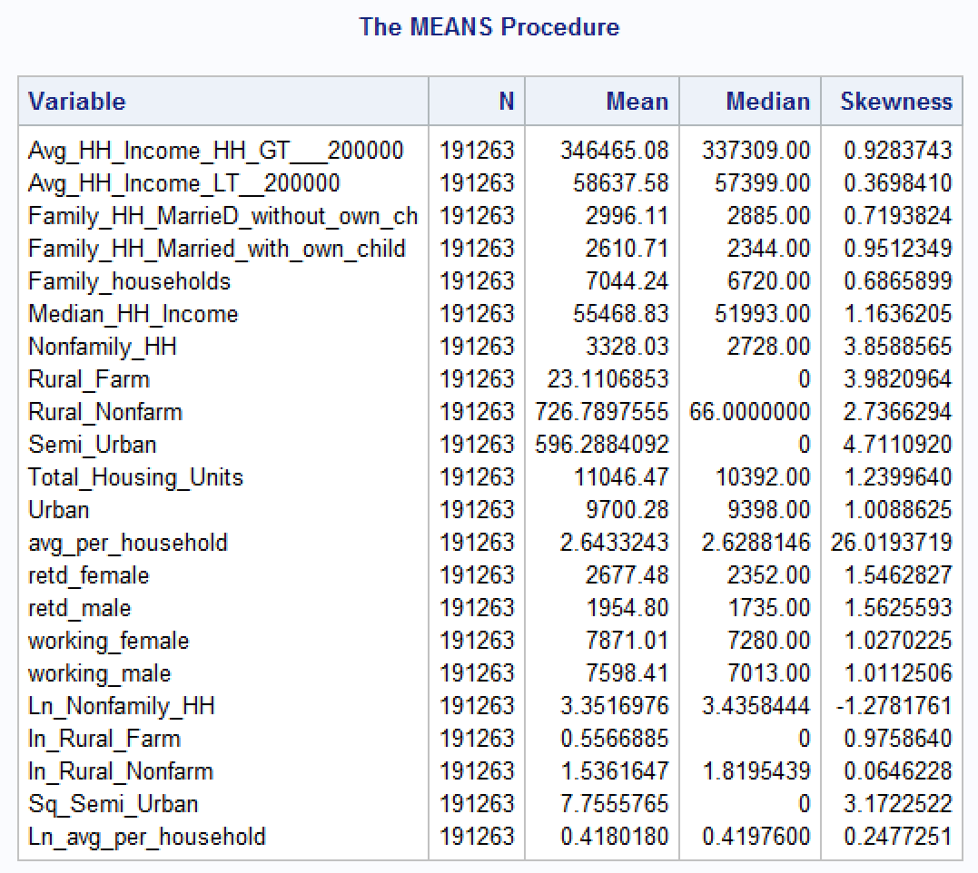
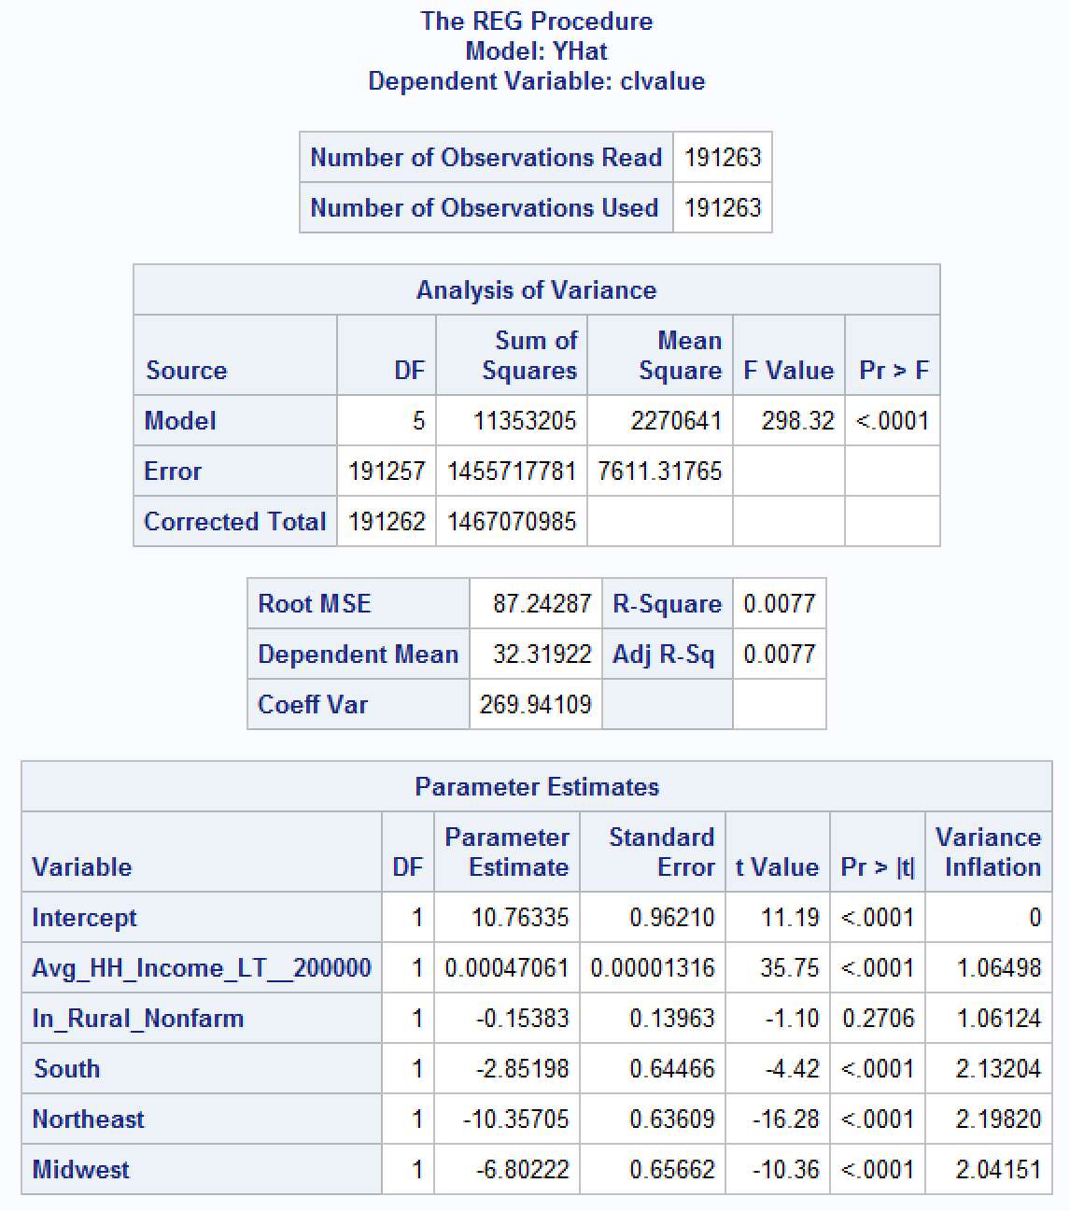
Customer Lifetime Value Analysis
Customer life time value was calculated by adding appeal costs to donation amount.
Some of the variables such as Rural non farm, semi urban etc. had significant positive skewness. So log values or square root values were taken for them
Data was standardize using proc standard and we ran multiple regression models.
No conclusive results were obtained from the model output, hence we conclude that CLV just like donation amounts is not dependent on demographic factors.

Slide 20
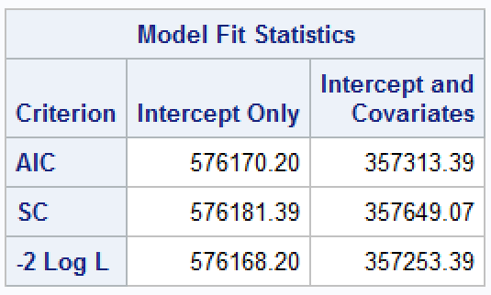
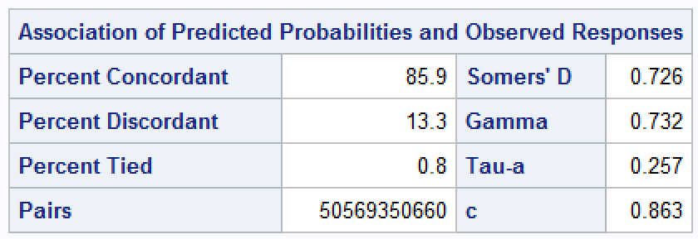
Donor Acquisition Recommendations
The earlier data was modified so that a conditional logit could be run.
The independent variables included in the model were – Dummy variables for each of the regions, Appeal costs, Appeal month and Donation month
The McFadden’s R square value for this model was 0.379
Coefficient obtained for Appeal cost was - 0.094, which means higher appeal costs do not guarantee higher donations.
Regions Northeast and Midwest have positive coefficients, so a targeted Marketing Campaign can help acquire more customers.
Appeals sent in June and December have highest positive coefficient

Slide 21
Appeals Analysis

Slide 22
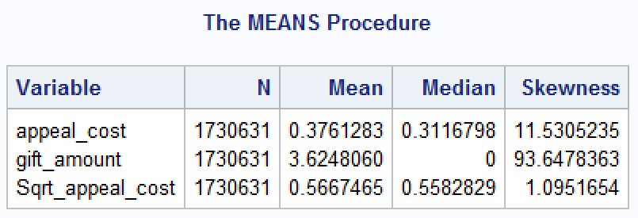
Objective
The purpose of this analysis was to check if appeals influence donations and are donations dependent on cost of appeals or timing of the appeal.
Data Preparation
Appeals data set was merged with donation dataset
A new binary variable donate was created, which had value ’1’ if the person donated and ‘0’ if appeal was unanswered
Gift and Appeals month and quarter were extracted from the data
Basis donor id’s the zip codes were mapped with the region in the US postal codes data
Dummy variables were created for the region
Appeal cost had a positive skew and square root of appeal cost was taken to remove the skewness

Slide 23
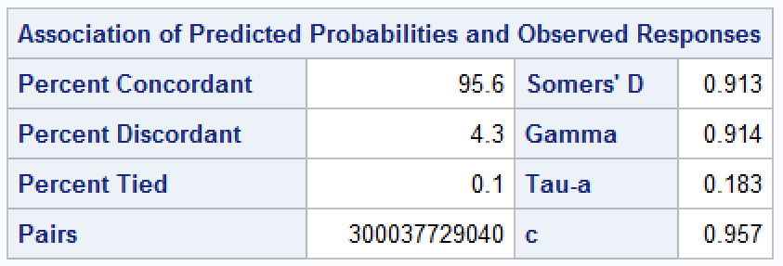
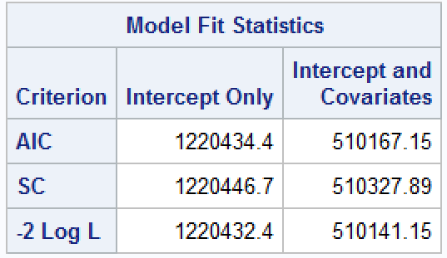
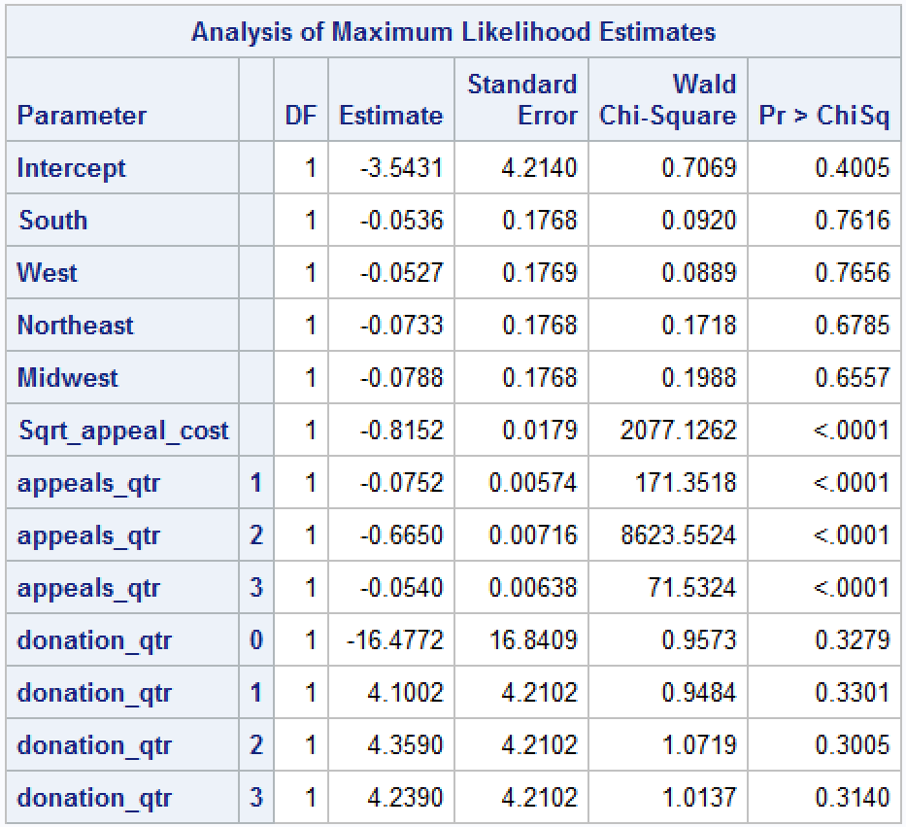
Logistic Regression
Logistic was run, with donate as the dependent variable
This model had a McFadden’s R Square value of 0.58
Quarter 4 is the most significant for sending appeals
donate (event='1')= South West Northeast Midwest Sqrt_appeal_cost appeals_qtr donation_qtr;

Slide 24
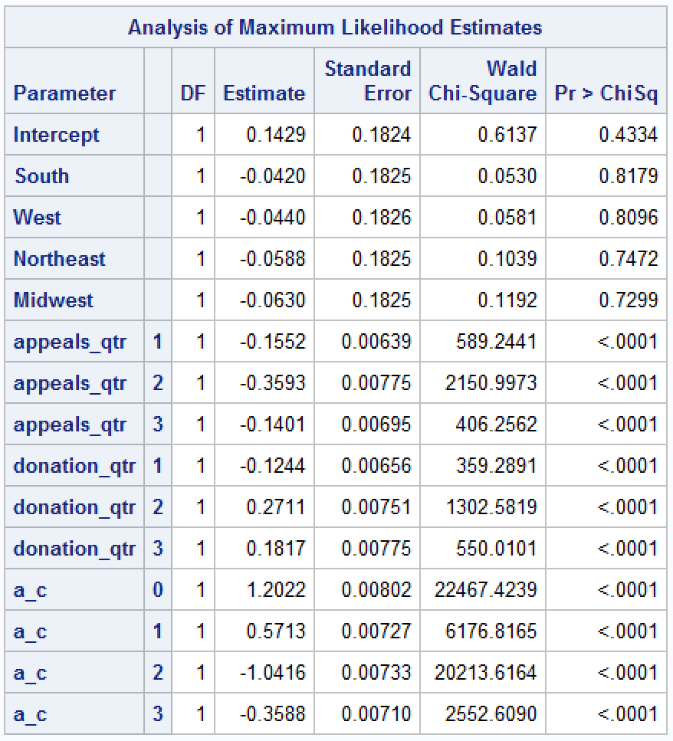
Appeal Cost Break Down
Appeals were ranked into 5 categories, 0 being the lowest and 4 being the highest
A logistic regression model was run with Donate being the response variable
model donate (event='1')= South West Northeast Midwest Sqrt_appeal_cost appeals_qtr donation_qtr a_c;
As evident from the results, rank 0($0 - $ 0.29) and rank 1($0.291 - $0.32) of donation perform better than the other 3 ranks
So as evident, we can say that the company gets better donation at lower cost and higher cost does not guarantee higher donation.

Slide 25
Behavioral Factor Analysis

Slide 26
Objective
Is past donation amount of a donor a good predictor of the future donation amount by that donor?
What patterns do we see in Recency and Frequency of past donations and Frequency of Future donation?
Do Recency and Frequency have significant impact on future donation behavior?

Slide 27
Pre-Processing
We modified the data and assigned quarters to every Gift Date of the donors, to which ever quarter the donated
Quarter was chosen as the time frame as it gives us the necessary amount of data points to conduct our analysis. Using Year would have yielded very few data points and using months would have yielded too many
Using RFM Analysis, we created 3 variables Recency, Frequency and Monetary and divided them into 5 classes 1 being the lowest and 5 the highest
We further created a extra variable called “Avg_mon” which is the average monetary value for each donor

Slide 28
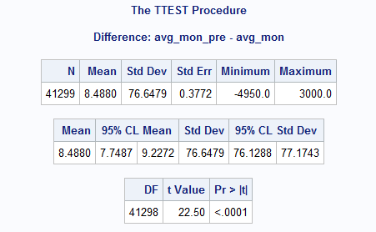
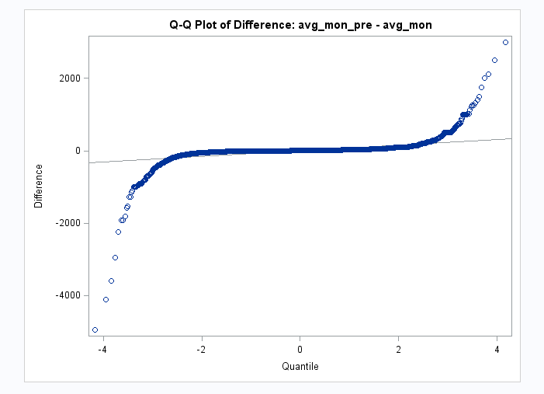
Prediction through past monetary value
We ran a paired T - test and a regression analysis to test the following Hypothesis –
H0: μd = μ0 - The population mean of the differences (μd) equals the hypothesized mean of the differences (μ0).
H1: μd ≠ μ0 - The population mean of the differences (μd) does not equal the hypothesized mean of the differences (μ0).
As evident, we can see the p value to be less than <0.05, which means we reject the null hypothesis
Seen in the Q-Q plot above, we see that majority of differences between past and future monetary values tends to be near 0

Slide 29
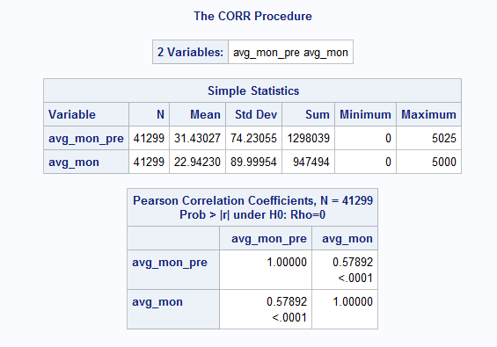
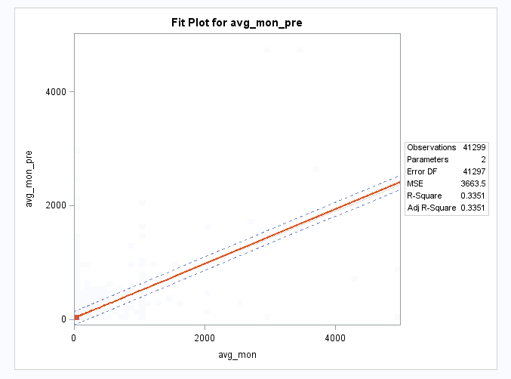
Prediction through past monetary value
We ran a regression and correlation to further check our findings –
Seen in the table above, we can see there is some correlation and also the regression line is linear
There seems to be a decent correlation between the past and future Monetary values
Hence we conclude that past monetary amount of a donor is a good factor to predict its future donation.

Slide 30
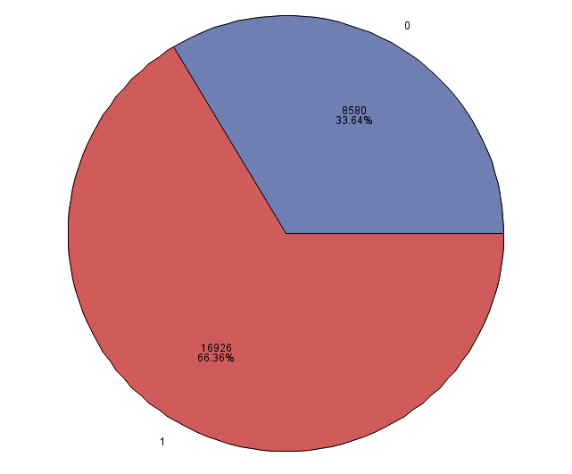
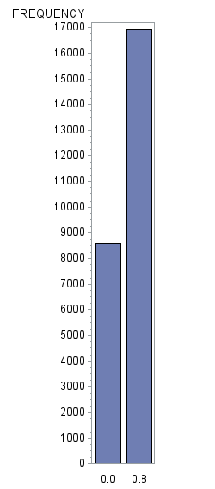
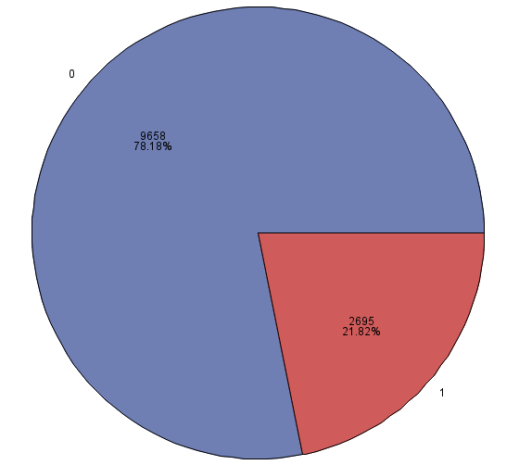
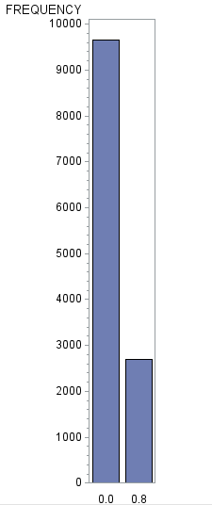
Relation between past recency and frequency and future number of donation
We ran multiple models such as Regression, Correlation Matrix, Frequency tables etc. to see what patterns emerge
We divided our past recency into two parts –
Part 1 –Included only those Donors (Made a column and updated it with value 1 if donated) who donated in the latest year of Pre data i.e. year 2003.
Part 2 – Included only those Donors (Made a column and updated it with value 0 if not donated in the latest year) who haven’t donated anything in the latest year of Pre data that is there is no donation from their side in the year 2003.
Chart for Donors who donated in the past one year Chart for Donors who didn’t donate in the past one year
As seen in the chart, we can clearly see that there is a higher probability of donating for those donors who donated in the latest year than those who didn’t.

Slide 31
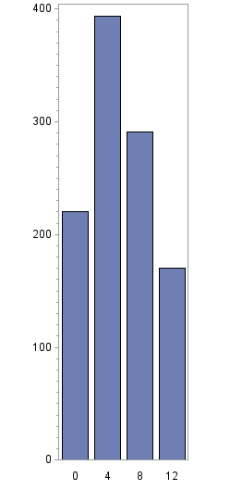
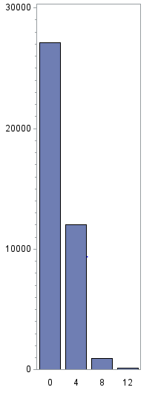
Relation between past recency and frequency and future number of donation
Similarly, we divided data into two parts to see the effect of frequency –
Part 1 – Donors having donated more than 8 in the Pre Data (year 2000 – 2003)
Part 2 - Donors having donated less than or equal to 8 in the Pre Data ( Year 2000 – 2003 )
Frequency greater than 8 Frequency Less than equal to 8
As seen above, it is very evident if donors actively donate throughout the year (more than once every quarter, hence the cutoff ‘8’) tend to donate in the future as well (Year 2004 – 2006).

Slide 32
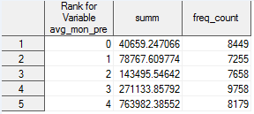
Pareto’s Law Analysis
Pareto’s Principal states that, “80% Value comes from 20% Customer”
We grouped up our data by average monetary value and number of Donors in the 5 classes of frequency
As seen from the table, almost 73% sales comes from 22% of customers.
We can conclude that Recency and Frequency of the past has significant impact on number of donations in the future.

Slide 33
THANK YOU !

